Slide 1

Wildlife tracking project
Extracting bear pictures from emails
Anthony LELCHAT
Ostbayerische Technische
Hochschule Regensburg
Regensburg, Germany
anthony.lelchat@extern.oth-regensburg.de
Jan DÜNNWEBER
Ostbayerische Technische
Hochschule Regensburg
Regensburg, Germany
jan.duennweber@oth-regensburg.de
Internship date : 14th December – 13th February

Slide 2
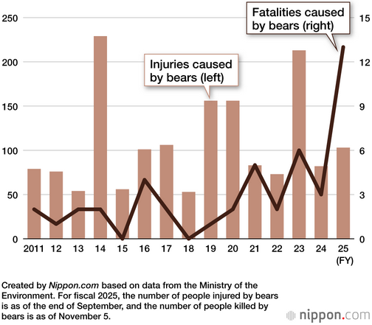
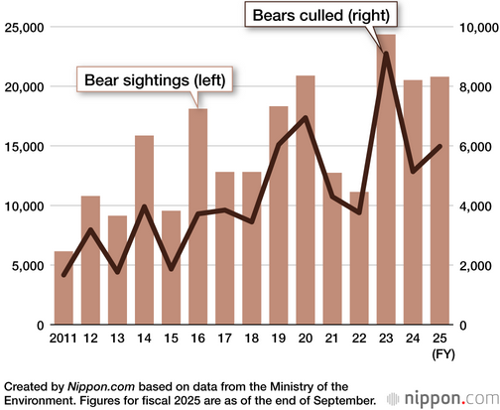
Introduction
Climate change effect (food, hibernation).
Existing solutions like cameras.

Slide 3
Plan
Presentation of the project
Functionalities of the project
Contribution to the existing system.
Possible improvement to the system

Slide 4
Plan
Presentation of the project.
Functionalities of the project.
Contribution to the existing system.
Possible improvement to the system.

Slide 5
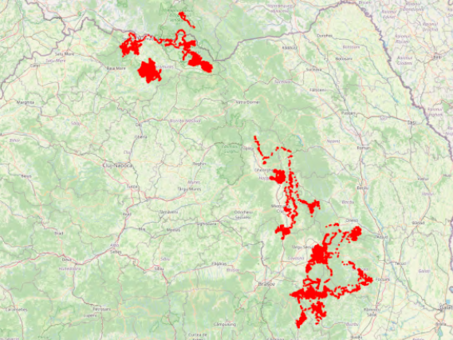
Presentation of the project : How the project works (Romania).
Tracking the brown bears.
Romanian dataset:
  13 brown bears (2011-2015)
  60 000 GPS points
  Hourly tracking
  Mix of forest, meadows, steep terrain
  Bears vary in age, sex & seasonal behavior

Slide 6
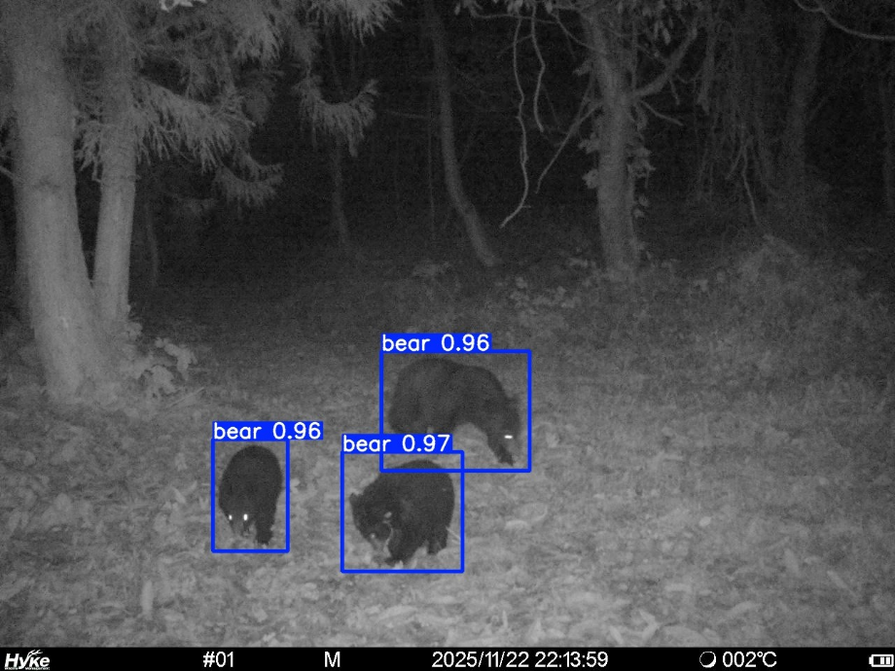
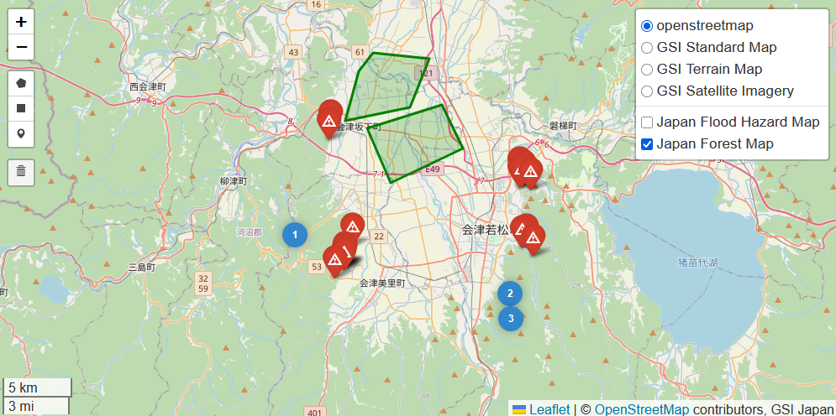
Presentation of the project : How the project works (Japan).
Tracking the black bears.
Cameras placed in rural and semi-mountain areas
Cameras connected to Raspberry Pi that send pictures by emails.

Slide 7
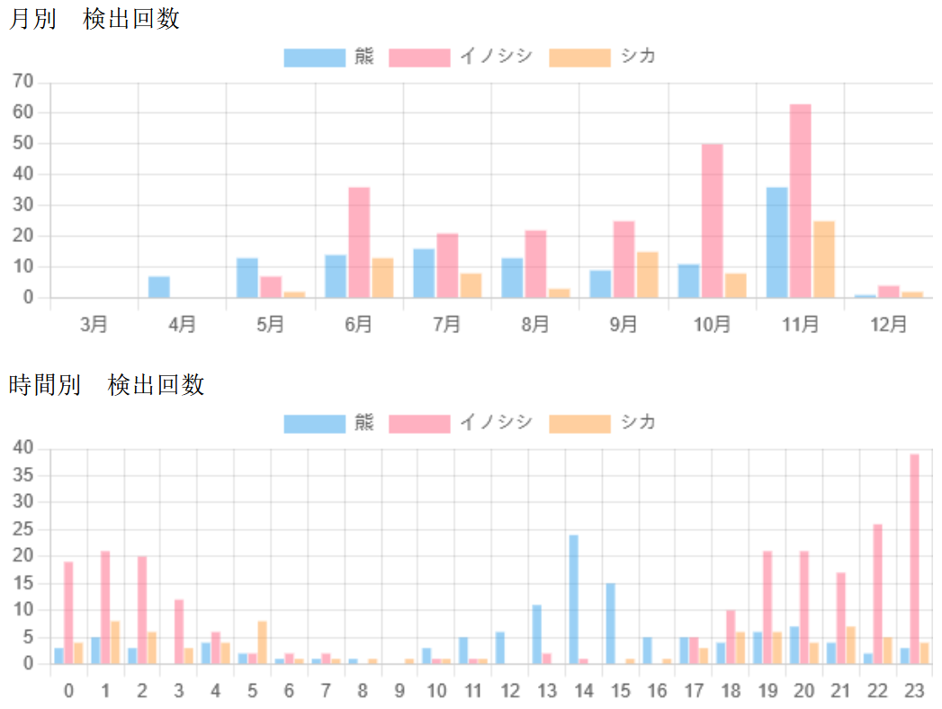
Presentation of the project : How the project works (Japan).
Camera gives statistics on the wildlifes
Monthly and hourly sightings.
Bears in blue, boars in pink and deers in orange.

Slide 8
Plan
Presentation of the project.
Functionalities of the project.
Contribution to the existing system.
Possible improvement to the system.

Slide 9
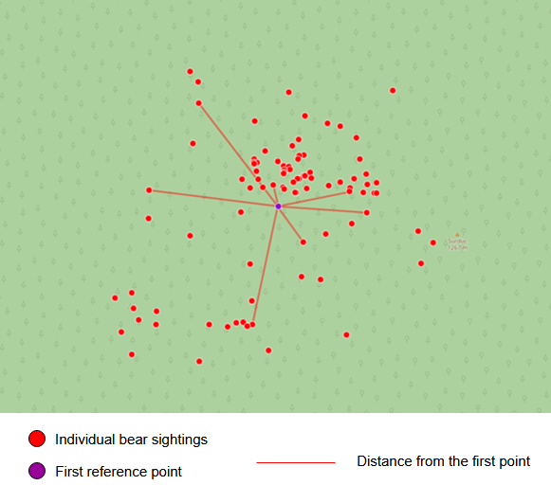
Functionalities of the project : Determine hotspots
Solitary animal that tend to regroup:
  In Spring to mate
  In Summer to fish
  In Autumn to look for a safe place
Algorithm of Weiszfeld for the geometric median of a set of points.

Slide 10
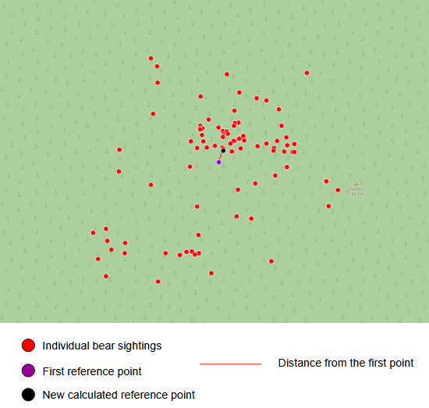

Functionalities of the project : Determine hotspots
A weight correspond to the influence of a point in the calculation reference point
Every point receive a weight (1/distance)
A short distance to the reference point equals to a high weight

Slide 11
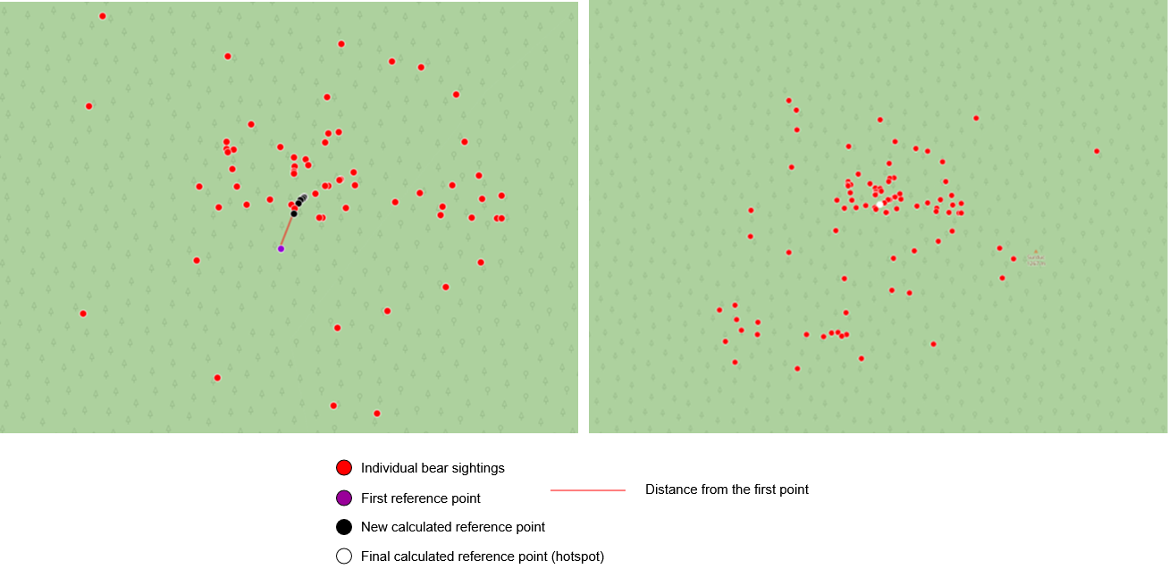
Functionalities of the project : Determine hotspots
Insignificant distance between two reference point equals to a hotspot.

Slide 12
Functionalities of the project : Determine bear path
AI model that determine bear path through many factors:
  The terrain type (forest, meadow, slope)
  The distance and the angle toward hotspots
  The age and sex of the bears
  The season and the time of the day
  The avoidance of steep or open areas
73% accuracy on determining bear path
Main issue : Relying only on historical data for japanese black bear

Slide 13
Plan
Presentation of the project.
Functionalities of the project.
Contribution to the existing system.
Possible improvement to the system.

Slide 14



Contribution to the existing system : Project Architecture
Backend
Python for acquiring and processing data, doing simulation…
Database
MariaDB to store bear data, camera location, hotspots…
Frontend
Streamlit (Python framework) to show wildlife data (pictures, camera location)

Slide 15

Contribution to the existing system : Accessing inbox
Access to a shared mail
A few packages were considered (exchangelib, Microsoft Graph API and dbmail)
  dbmail doesn’t support shared mail services
  OAuth2 credentials and Azure Portal created issues.
  Exchangelib require a complex configuration and will be deprecated.
Microsoft Graph API remains the best solution (REST API with a minimal configuration on Azure Portal)

Slide 16
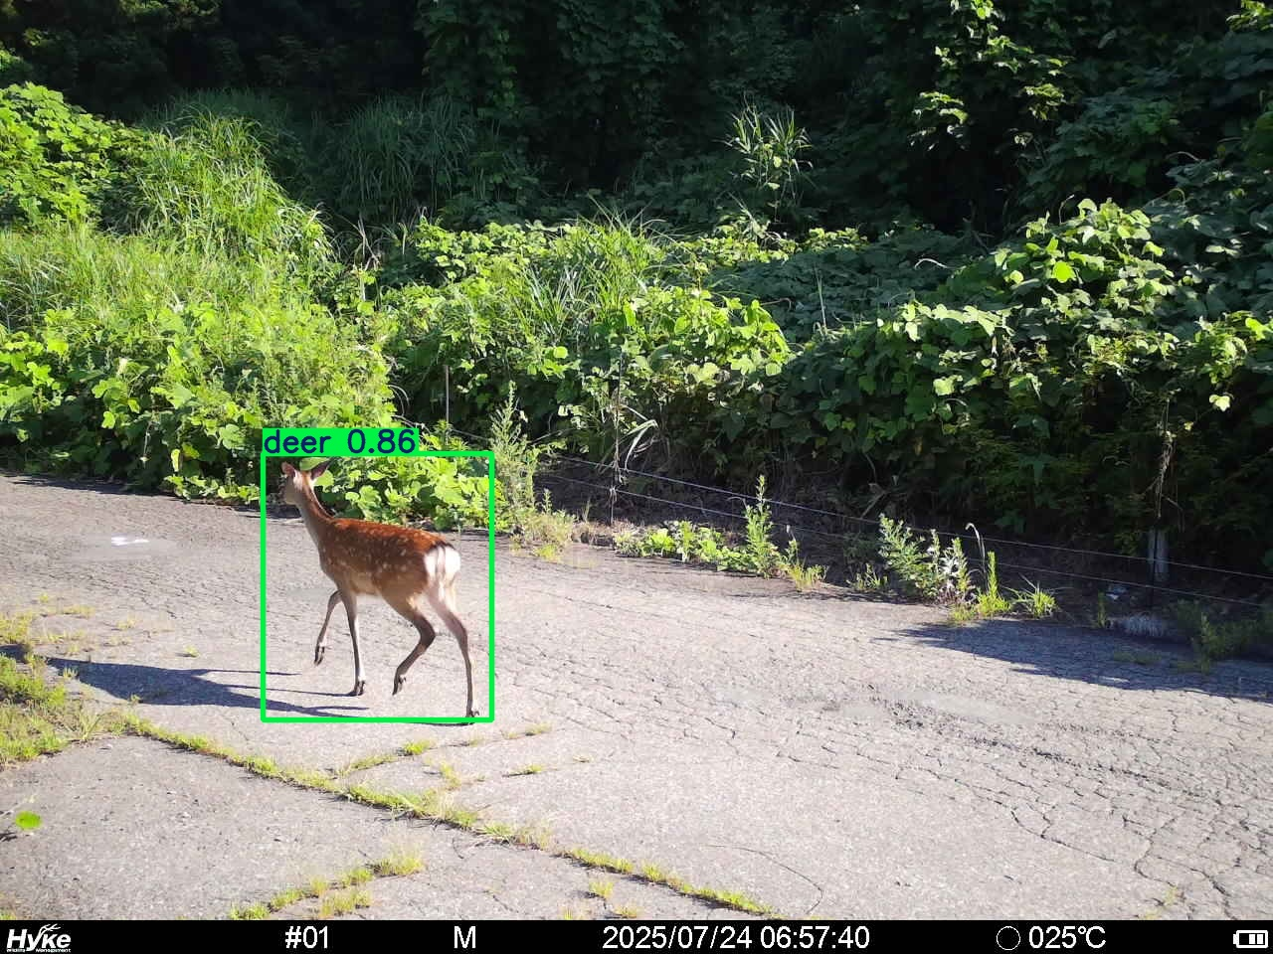
Contribution to the existing system : Parsing pictures
Important information for every pictures (type of animal, timestamp and camera identifier)
Two packages considered to parse images (pytesseract and easyOCR)
  pytesseract is light but need a complete and detailed configuration (parsing issues)
  easyOCR is heavy but very efficient
EasyOCR is the most adaptative package to use.

Slide 17
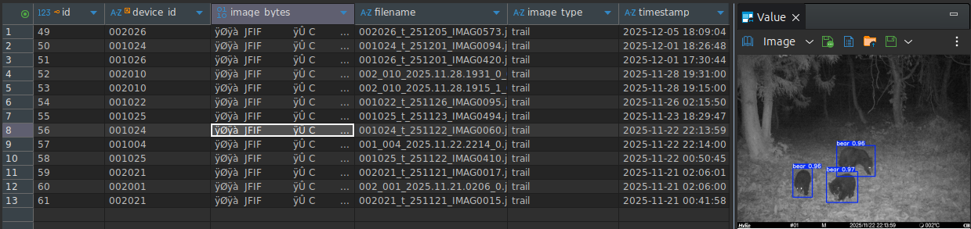
Contribution to the existing system : Storing pictures
When parsed, data are inserted into the database.
Pictures can be visualized

Slide 18
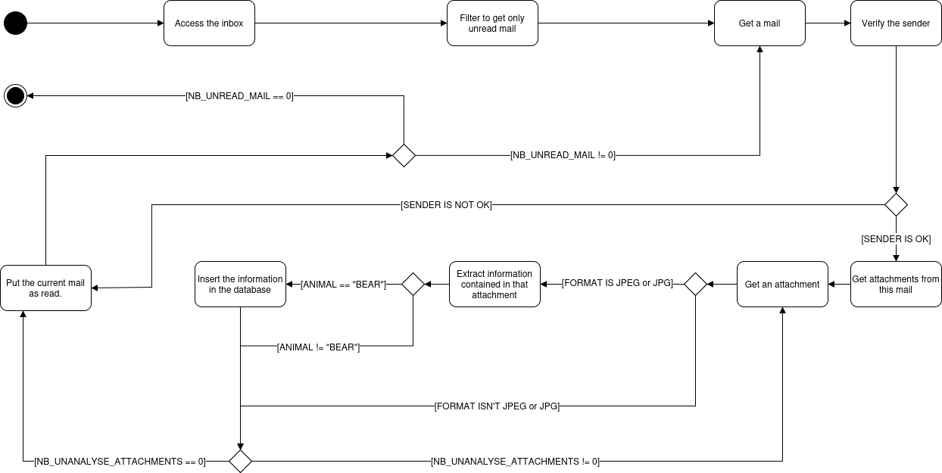
Contribution to the existing system : Processing emails and pictures
Processing part use all modules we created before.

Slide 19
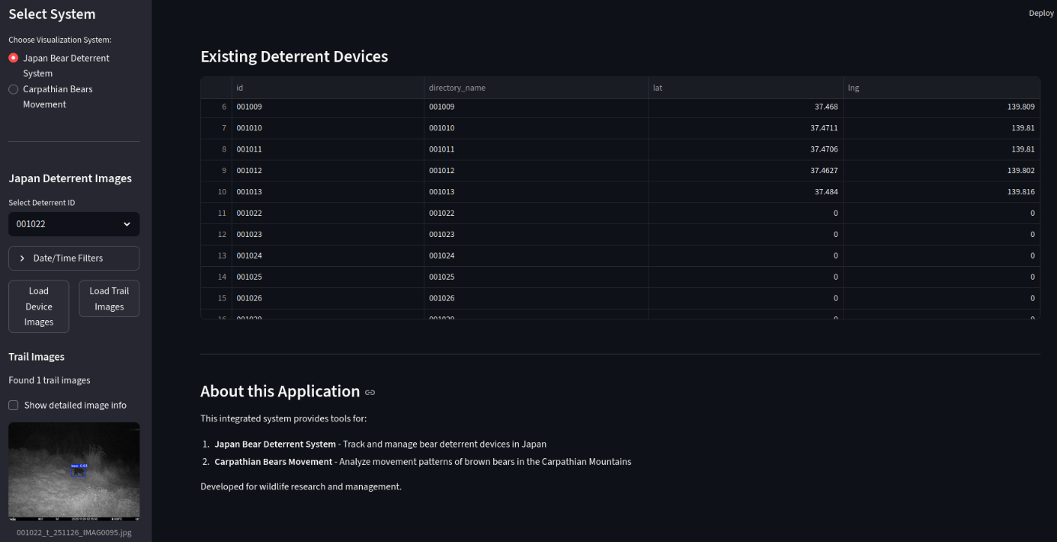
Contribution to the existing system : Adapting the web interface
Previous model : path in database, pictures on server file system
New model : pictures as BLOBs into the database

Slide 20
Plan
Presentation of the project.
Functionalities of the project.
Contribution to the existing system.
Possible improvement to the system.

Slide 21
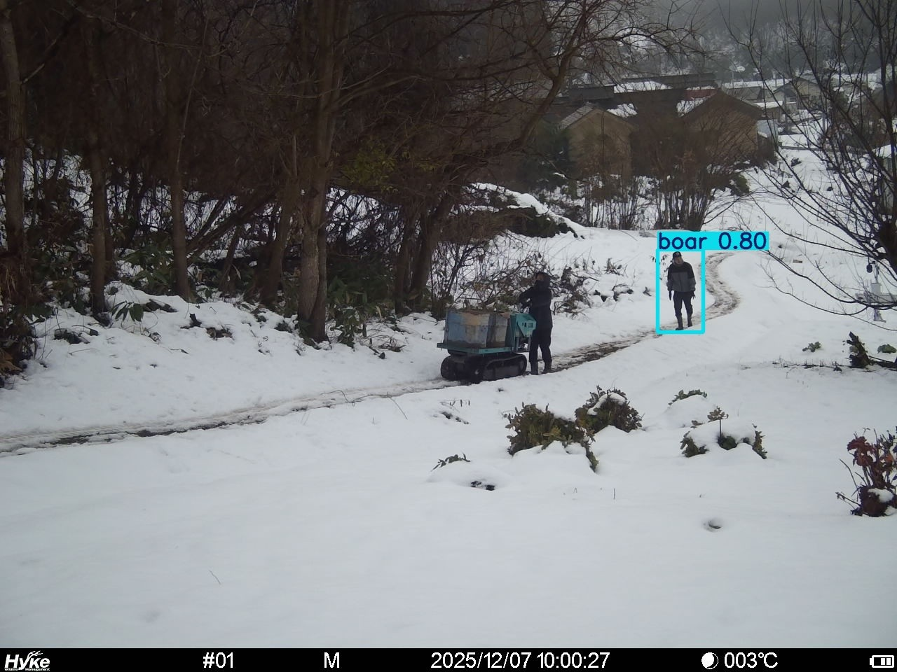
Possible improvement to the system : Animal detection error
Type man exists but the pictures isn’t recognized correctly.
Lead to inconsistency in the database.

Slide 22
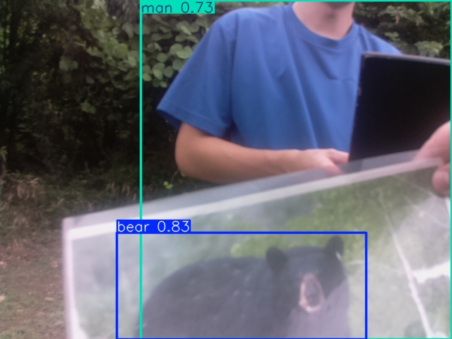
Possible improvement to the system : Picture missing information
Information in the bottom are missing
Not critical (all needed data in the filename)

Slide 23
Conclusion
The project allows the use of real times data for the japanese dataset
Enriching experience on all aspects
  Professionally for my involvement in the project.
  Personally for the discussion I had with masters students.
  It helped me improve my english skills.

Slide 24
Thank you for your attention

